Slide 1
EMA/WGLG Service Review Forums 2024
FE Account Managers, Partner Services
Kay Vizard-Kotkowicz (Wales)
Katy Barge
April 2024

Slide 2

Agenda
Registration and housekeeping
You tell us
Common queries
LC website tour
SLC engagement, you asked we delivered
Break
Test your knowledge
Case studies
Service standards
Service update
AOB

Slide 3


Slide 4

Introductions
Q1.
Have you attended a SLC forum before?
Yes (face to face)
Yes (virtually)
Yes (both face to face & virtually)
No
Q2.
How experienced are you in administering EMA?
Very experienced
Fairly experienced
A little experienced
Not at all!
Q3.
What would like to get out of today's forum?

Slide 5

Common Questions
Q) What could be the consequences of not confirming attendance every week as per the service standard be?
To minimise the risk that students may not be paid if a payment weeks attendance is also missed. In addition to complying with the service standard (100% confirmations weekly).
Q) Under what circumstances should I use remove, stop, suspend ?
Remove – When a student has not signed a learning agreement, suspend is when they have signed a LA and you have a long-term sickness/ AWOL, stop is when they have signed a LA and have decided to withdraw
Q) Which 2 documents will still be found on the portal for 24/25 and where will all other documents/posters/booklets etc be found?
LA & payment info guide
On the LC website – we will show you later in the presentation
Q) Where can I find the student’s application received date to see if they are eligible for full back dated pay.
A) Customer search – view application details

Slide 6

Learning Centre Website
Why do we have a 2-day rule?
Where can I find information regarding illness/absence ?
Is there a quick guide I can access for inputting a learning agreement, I’m new to the role and I’ve never done one?
I need a reminder of what the service standards are, where can I find them?
Where can I find promotional materials for 24/25 for EMA/WGLG?
www.lcservices.slc.co.uk

Slide 7
Engagement with SLC

Slide 8

LCs contact with EMA info
Month | Call | Email
Jan-23 | 89 | 878
Feb-23 | 44 | 578
Mar-23 | 64 | 679
Apr-23 | 28 | 600
May-23 | 35 | 741
Jun-23 | 41 | 627
Jul-23 | 25 | 603
Aug-23 | 32 | 805
Sep-23 | 109 | 1751
Oct-23 | 133 | 1862
Nov-23 | 88 | 996
Dec-23 | 50 | 744
Jan-24 | 53 | 854
Feb-24
Total | 791 | 11718
This Photo by Unknown Author is licensed under CC BY-SA

Slide 9

Call Reasons
Payment queries
Learning centre or campus changes
Cannot locate student app on Learning Centre portal
Help with removing/restoring student applications
Course start date changes
Status/evidence requirement queries
Reassessing WGLG applications after LC error on course details

Slide 10

Account Manager Engagement
2022/23 forums – 92 EMA administrators attended
Direct contact with LCs
42 Face to face meetings at schools/colleges
10 virtual online reviews with schools/colleges

Slide 11
You asked - we delivered
Added export to EMA attendance, application and learning agreement worklists
Added export to WGLG attendance & application worklists
User details tab to default to ‘hide inactive users’
You can now add group names up to 30 characters long
You can now click on enter after you have inputted a student's name etc rather than having to press return
Default attendance weeks within EMA customer search to 75
We now have a removal report PDF and Excel
Warning message before submitting learning agreement
Welsh characters can now be used
On our wish list – Re set average days
When a student transfers to a new LC
If an application is awaiting information but the average days are still counting (typically when they have been sample checked).
Notes:
Added export to EMA Attendance, application and learning agreement worklists - you can now export
Added export to WGLG Attendance & Application worklists – you can now export
User details tab to default to 'Hide inactive users’ – prior to this all users showed first and you had to tick the box to just see current users
You can now add group names up to 30 characters long - was restricted to less before
You can now click on enter after you have inputted a student's name etc rather than having to press return – you had to click on search before
Default attendance weeks within EMA Customer Search to 75 – was on 25 before
We now have a Removal Report PDF and Excel – new report
Warning message before submitting Learning Agreement – helps to give you the opportunity to double check before saving
Welsh characters can now be used

Slide 12
BREAK

Slide 13
Test your Knowledge

Slide 14


Can you remove a student who has not signed their learning agreement after 10 working days, even if you know they are studying with you?
This will help protect your service standard. SLC Will ask the student to sign a LA via letter. The LC will ask them to sign their learning agreement and SLC will also send reminder text’s etc. You can always restore once they want to sign it.

Slide 15

If your register has some missing attendances marks you should leave the portal attendance confirmation blank until you know if the student was in attendance or not.
You should never leave an attendance confirmation blank it should be marked as not in attendance until you have proof of attendance.

Slide 16
You need to contact your account manager for an account
review to find out how you are performing against the service
standards.
Service standard reports are available on the portal - self service report helps provides an overview of your Learning Centre and provides a regional sector comparison.

Slide 17
Extenuating circumstances can only be used/ticked for child carers.
The purpose of this is to support vulnerable students who are at risk of not participating in education. This may include caring responsibilities or disabilities but is not limited to these.

Slide 18
Case Studies

Slide 19
Case Studies
Working in groups think about the following scenarios
1, An EMA student is studying 4 subjects and is studying full time at the start of the AY year.
They decide to drop 2 mid-year as they are not enjoying the subjects.
What would you as an admin need to check to make sure they are still eligible for EMA.
2, We carry out 2 sample checks on returning students during the year. One in the summer before they return and another in Nov/Dec time.
What is the difference between these 2 sample checks and what evidence are we requesting from the student/parent/guardians ?
How can you identify and support these students that have been selected by using the portal ?
3, Make 2 list of as many authorised and unauthorised absence reasons as you can.

Slide 20

Case study 1
An EMA student is studying 4 subjects and is studying full time at the start of the AY year. They decide to drop 2 mid-year as they are not enjoying the subjects. What would you as an admin need to check to make sure they are still eligible for EMA.
https://www.lcservices.slc.co.uk/ema-wales/guidance/guidance-notes-for-ema-learning-centres-in-wales/eligibility/eligible-courses/
Things you should check
At least 10 weeks' duration
At least 12 guided contact hours per week
Are they still studying an eligible course e.g. A level, AS Level
Have registers been updated?

Slide 21
Case study 2
We carry out 2 sample checks on returning students during the year. One in the summer before they return and another in Nov/Dec time.
What is the difference between these 2 sample checks and what evidence are we requesting from the student/parent/guardians ?
How can you identify and support these students that have been selected by using the portal ?
Guidance can be found on the portal
https://www.lcservices.slc.co.uk/ema-wales/guidance/guidance-notes-for-ema-learning-centres-in-wales/eligibility/sample-checking/
The difference between them is
Summer sample check is to check the household income is still below the EMA threshold.
Nov/Dec sample check it is to prove that they are still financially dependent on the household income since they originally applied.
You can use the sample check reports to identify any students that have been selected.

Slide 22
Case study 3
A, make a list of as many authorised and unauthorised absence reasons as you can – full lists can be found using these links below.
https://www.lcservices.slc.co.uk/ema-wales/guidance/guidance-notes-for-ema-learning-centres-in-wales/absence/authorised-absence/
https://www.lcservices.slc.co.uk/ema-wales/guidance/guidance-notes-for-ema-learning-centres-in-wales/absence/unauthorised-absence/
Authorised | Unauthorised
medical appointments that could not be made outside of school or college hours | holidays, as students are expected to take these outside of term time
a driving test | leisure activities
delayed or cancelled public transport | birthdays or family celebrations
attending a funeral, wedding or civil ceremony of a close family member | babysitting siblings (not including family emergencies)
a visit to a university open day or a career-related interview | part-time or full-time work that is not part of the study programme

Slide 23
AY 23/24 Performance against Service Standards

Slide 24
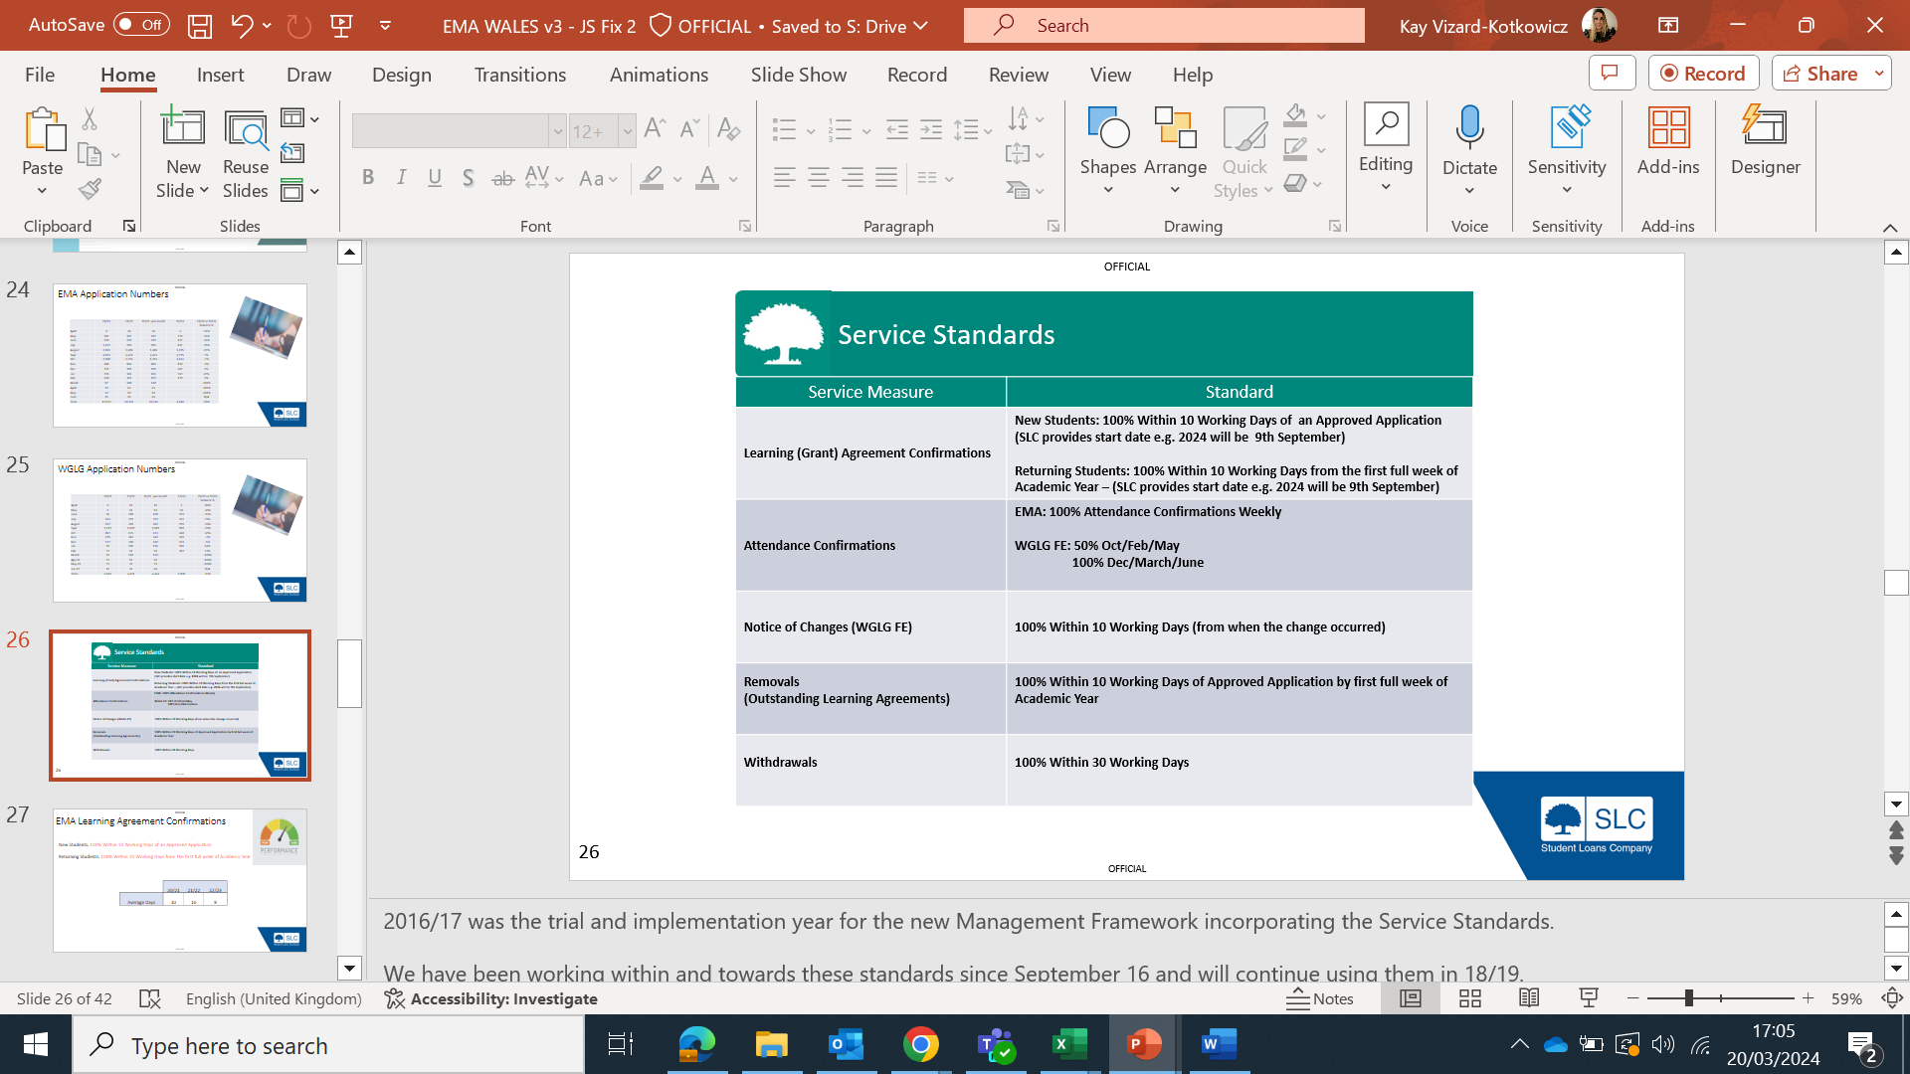
EMA/WGLG Service Standards

Slide 25
WGLG Application Numbers
Month Application Received | 21/22 | 22/23 | 23/24 | 22/23 & 23/24 Variance
April | 3 | 2 | 4 | 50%
May | 54 | 35 | 25 | -40%
June | 120 | 107 | 66 | -62%
July | 181 | 144 | 105 | -37%
August | 384 | 239 | 304 | 21%
September | 1,295 | 1,133 | 1,293 | 12%
October | 625 | 662 | 708 | 6%
November | 403 | 343 | 343 | 0%
December | 153 | 196 | 150 | -31%
January | 109 | 176 | 161 | -9%
February | 79 | 130 | 106 | -23%
March | 77 | 92
April | 44 | 46
May | 67 | 55
June | 11 | 15
July | 1 | 2
August |  | 1
Total | 3,606 | 3,378 | 3,265 | -3%

Slide 26
WGLG Learning Agreement Confirmations
New Students: 100% within 10 working days of an approved application
Returning Students: 100% within 10 working days from the first full week of academic year
 | 21/22 | 22/23 | 23/24
Average Days | 5 | 5 | 5

Slide 27
WGLG Attendance Confirmations
WGLG FE: 50% Oct/Feb/May (mid term)
100% Dec/March/June (end of term)
Date | 22/23 | 23/24 | Notes
Oct (mid term) | 98% | 86.5% | 50% Requirement
Dec (end term) | 100% | 95.6% | 100% Requirement
Feb (mid term) | 97% | 95.7% | 50% Requirement

Slide 28
EMA Application Numbers
Month Application Received | 21/22 | 22/23 | 23/24 | 22/23 & 23/24 Variance
April | 33 | 16 | 100 | 84%
May | 386 | 370 | 485 | 24%
June | 1,233 | 754 | 992 | 24%
July | 1,153 | 834 | 976 | 15%
August | 2,594 | 1,787 | 2,460 | 27%
September | 8,045 | 8,236 | 8,422 | 2%
October | 2,314 | 2,530 | 2,393 | -6%
November | 1,095 | 816 | 872 | 6%
December | 332 | 299 | 302 | 1%
January | 139 | 226 | 241 | 6%
February | 142 | 155 | 156 | 1%
March | 108 | 116
April | 44 | 52
May | 40 | 34
June | 10 | 18
July | 7 | 7
August | 8 | 7
Total | 17,683 | 16,257 | 17,399 | 7%

Slide 29
EMA Learning Agreement Confirmations
New Students: 100% Within 10 Working Days of an Approved Application
Returning Students: 100% Within 10 Working Days from the first full week of Academic Year
 | 21/22 | 22/23 | 23/24
Average Days | 10 | 8 | 7

Slide 30

EMA Attendance Confirmations
EMA: Attendance confirmations on payment week
 | 22/23 | 23/24
EMA Payment week | 95.3% | 97.2%
EMA Non-Payment week | 92.8% | 94.1%
(NB – 100% weekly confirmations are required as per service standard)

Slide 31
Welsh Government Update

Slide 32
EMA/WGLG Policy Changes for AY24/25
Family Members of Ukraine Nationals​
From AY 24/25, family members of Ukraine Scheme leave holders will be eligible to apply for FE support. ​
​
Family members of Afghan Citizens​
From AY 24/25, family members of those granted leave under the Afghan Relocations and Assistance Policy (ARAP) or the Afghan Citizens Resettlement Scheme (ACRS) will be eligible to apply for FE support without any​ requirement for them to have been granted leave in line. ​
​
Continuation of student support where leave has expired:​
Changes will be made to SLC guidance to make clear that persons with leave can continue to access support once original leave expires, if they have a new lawful immigration status in the UK.

Slide 33
EMA/WGLG Policy Changes for AY24/25
The Welsh Government are considering a new extension scheme for Ukraine because as of “19 February 2024, the Home Office announced that it will be introducing a new Ukraine Scheme called the “Ukraine Permission Extension Scheme”.
This scheme will be available to those who have previously been granted leave under one of the current Ukraine Schemes. Leave under the Ukraine Permission Extension Scheme will be limited temporary leave that is granted for a period of 18 months at a time, with the first grant of leave under this scheme made in March 2025”

Slide 34
Promotional Materials
Apply now posters for EMA/WGLG PDF are available on the LC Website.
LBOEMA and guide to WGLG PDF are available on the LC Website NOW
LBOEMA and guide to WGLG paper copies (Colleges with 20+ EMA/WGLG Learners) were delivered on 6th March 2024
EMA/WGLG application forms were delivered week comm 15th April 2024 please contact emainfo@slc.co.uk if not received by 26th April. LC’s with under 10 learners on EMA are encouraged to print off online.
Service Launch
NB-The 2024/5 EMA academic year start date will be Monday 9 September 2024. This is when we begin to count the 10-day period for students to sign their learning agreements.
Launch was on week comm 8th April, this is when paper application forms became available to print off online and students can start applying from – online launch date TBC.
Learning Agreements 24/25 will be available from week comm 8th April 2024

Slide 35


Slide 36

FE Account Manager
Kay_Vizard-Kotkowicz@slc.co.uk
0776 9165135
PS Support Desk
EMAINFO@slc.co.uk
0300 200 7089 (Select option 5)
This Photo by Unknown Author is licensed under CC BY
Notes:
Partner Services
EMAINFO@slc.co.uk
0300 200 4050

