Slide 1
EMA Service Review Forums
FE Account Managers - Partner Services
April 2026

Slide 2

Agenda
Service standard reports
Promoting EMA
Common questions
Learning agreement content
EMA inspections
Preparing for academic year (AY) 2026/27
Service update

Slide 3


Service standards
You can monitor your Learning Centre’s performance against the service standards at any point of the year. You can:
See how your Learning Centre is performing against Northern Ireland’s average
Check to see how many applications you have had over the years
Let’s take a look on the next slide

Slide 4
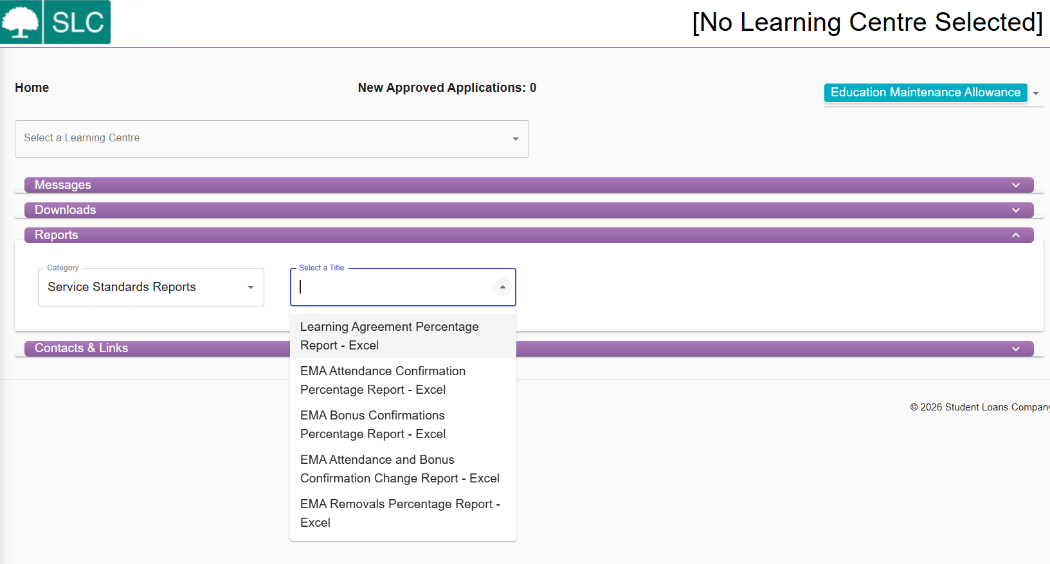
Reports
Notes:
Red box highlights the two reports which outline performance against three key service measures

Slide 5
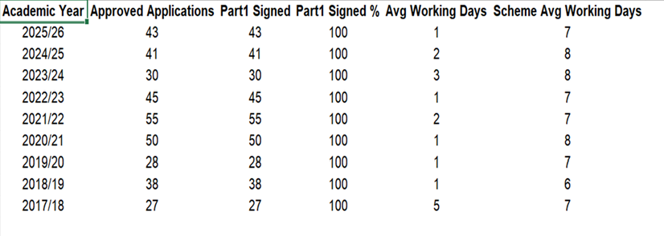
Learning agreement average days

Slide 6
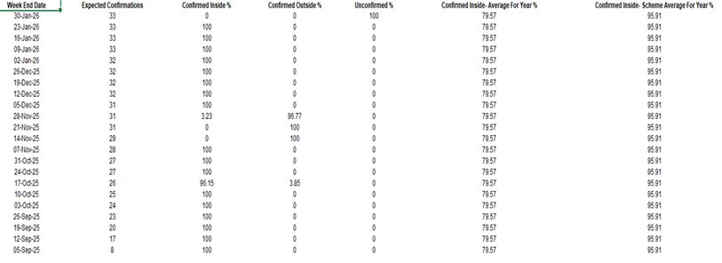
Average attendance confirmations

Slide 7
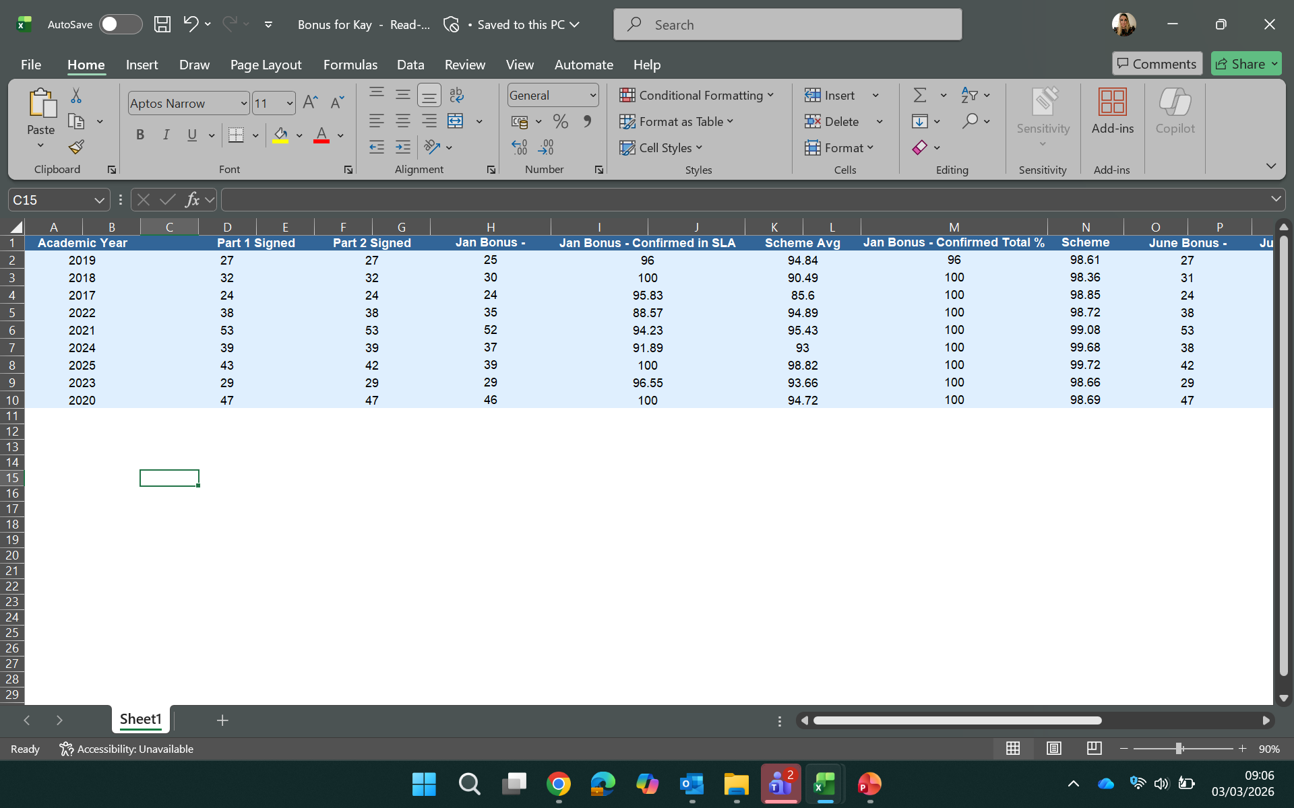
January and June bonuses

Slide 8
Promotion – working together
  Which SLC resources do you use to promote EMA?
  Little book of EMA
  Coming soon posters
  Apply now posters
  presentation to display on screens
How do you identify potential EMA students and promote the funding?
  parents’ salaries
  free school meals info
  class charts
  social media
If you don’t currently promote EMA, what barriers are you facing?

Slide 9
Timeline for applying and promotion
Timeline
We typically launch for the next AY
Encourage students to apply
Learning agreements need signing
Coming soon posters
March 26
April 26
May 26
June 26
Sept 26
December 2026
Students should apply over the summer
Start promoting to year 12
Little book of EMA
Start getting LA’s Signed
Bonus part 2 deadline

Slide 10
Applications for EMA

Slide 11
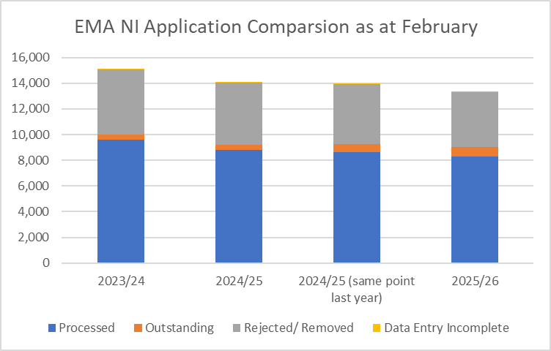
Volume of applications - comparison

Slide 12
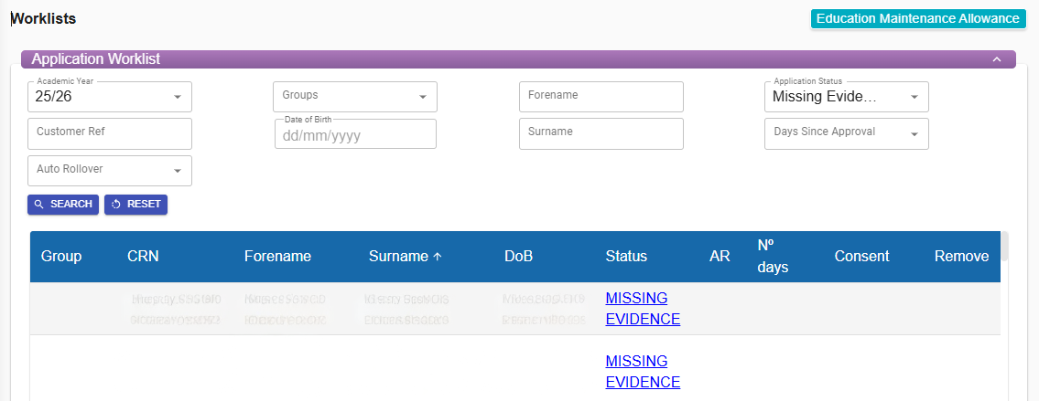
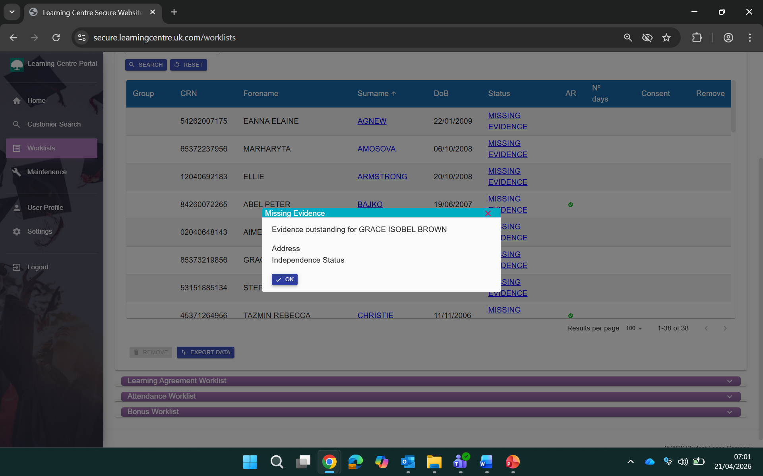
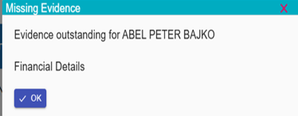
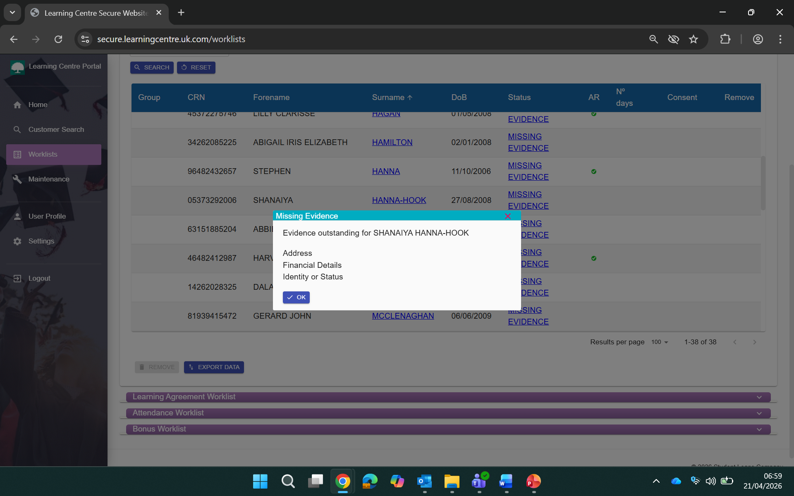
Missing evidence link

Slide 13
Common questions
If you need to give a new member of staff access to the portal, what should you do?
You can create a new user in the maintenance section of the portal. You should also expire any users who no longer require access.
How much can a student be absent before it starts to affect their EMA?
As per the guidance, there is no cap on how many times a student can be off ill as long as you’re confident the illness is genuine.

Slide 14
Under what circumstances should I use remove, stop, suspend?
You should only remove a student if they have not signed a learning agreement.
Remove
If a student leaves the learning centre permanently, you must stop the EMA Agreement. This will place a stop on the student record. You then no longer need to record attendance, and no more payments will be made.
Stop
You should suspend EMA Agreements for students who are absent long term from the learning centre and you are unsure if their absence will be permanent. You can then reactivate the EMA Agreement if they return.
Suspend

Slide 15


System enhancements
Delivered enhancements
Missing evidence and information added to the LC Portal – January 2026
Creation of ‘unconfirmed January/June bonus' link within homepage – July 2025
Remove restriction on LC Portal users being able to update previous AY apps – September 25
Enhancements on our wish list
Re-set average days – if an application is awaiting information and the average days are still counting (typically when they have been sample checked).

Slide 16
Learning agreements

Slide 17

Learning agreements – common mistakes
Blank learning agreement
Inserting an overall attendance threshold. For example, the student must be in attendance 95% of the school year
Caping the number of authorised absences
Attending registration included within the attendance criteria
Lateness
Inserting an attendance criteria within the bonus objectives

Slide 18
Example Learning Agreement – part 1
To receive your EMA you must attend 100% of your timetabled lessons.
Authorised absences can be considered as in attendance. A list of these can be provided by your school/college. The school/college have discretion if they believe the absence not to be genuine.
If you’re ill, you can self certify for up to 5 days in a row. After this, evidence such as a medical certificate will need to be provided.
Any unauthorised absences will result in nonpayment of EMA (evidence to support an unauthorised absence may be accepted within 3 weeks of the absence).
Any holidays authorised during term times will not be eligible for EMA payment.
You must be studying a course of a minimum of 15 hours to be eligible for EMA. For example, if the student is expected to attend for 20 hours, they must attend for 20 hours.
If you wish to appeal an attendance confirmation decisions, please ask the learning centre for further guidance.

Slide 19
Example Learning Agreement – part 2
This part of the EMA Learning Agreement sets out the performance and behavioural objectives students must achieve to receive bonus payments. It is the incentive for them to work to the best of their ability throughout their course.
The objectives should be realistic, clear, and unambiguous. They should also be adaptable to individual needs.
They should not be linked to specific grades or withheld until exam results are published.
To be considered for the EMA bonus payments in January and June, students must meet the bonus criteria.
They must have achieved or made satisfactory progress towards the objectives set out in the learning agreement.
Examples are:
  completion of coursework to a standard that is expected by the school/college
  attendance at public or internal examinations
  meeting behavioural standards in class and on field trips
  attending all work experience

Slide 20
EMA INSPECTIONS WITH EMA POLICY NI
Ensuring compliance through structured regulatory inspections

Slide 21
EMA INSPECTIONS

Slide 22
EMA INSPECTIONS
Purpose of EMA Inspections
  Inspections ensure compliance and proper administration of the EMA scheme within learning centres.
Inspection Components
  Review includes Learning Centre EMA Policy documentation, student records, attendance registers, learning agreements, and authorised absence evidence.
Goals of Inspection
  Maintain EMA programme integrity and ensure public funds support eligible students to remain in post compulsory education.
  Opportunities from Inspections
  Identify discrepancies and encourage improvements in learning center administration.

Slide 23
PURPOSE OF THE EMA INSPECTION
Notes:
A common issue identified at this stage was it was discovered the EMA administrator had moved and no handover was given to the new EMA administrator in addition the Department was not advised of any replacement contact details.
Already this process is an advantage to the LC’s as provides more notice to deliver up the information required.

Slide 24
Ensuring Policy Compliance
  EMA inspections verify that learning centres follow policy and regulatory requirements in administering the scheme.
Accurate Payment Processing
  Inspections confirm eligibility and ensure payments are made accurately and on time to students.
Fraud Detection and Prevention
  The inspection process helps detect and prevent fraud in the Education Maintenance Allowance scheme.
Continuous Improvement Support
  Regular inspections identify best practices and common issues to support ongoing improvements.

Slide 25
WHAT THE EMA GRANT IS INTENDED FOR

Slide 26
Purpose of EMA
  EMA supports eligible students in post-compulsory education, focusing on academic-related costs only.
Excluded Expenses
  EMA does NOT cover leisure, holidays, or personal expenses unrelated to education participation.
  Learning Agreement – EMA Bonus
  The EMA Bonus is intended to recognise and reward the achievement of pre-established performance and behavioural objectives agreed in Part 2 of the EMA Learning Agreement. Learning centres should ensure that expectations relating to attendance, behaviour and performance are clearly communicated and applied consistently to all students.
  EMA status should not result in different standards or additional sanctions being applied. Having EMA does not mean different rules apply. The same rules, expectations and disciplinary arrangements should apply equally to both EMA and non‑EMA students. This consistent approach supports fairness, transparency and the effective management of student performance across the learning centre.
Agreement of errors with LC and instruction to correct on SLC Portal, where appropriate.

Slide 27
EMA DESK BASED INSPECTION PROCESS

Slide 28
Notification and Preparation
  EMA inspections are conducted on a desk‑based basis. Learning centres are notified of an inspection by email and are asked in advance to provide key contact details and specified documentation. All requests for information, the submission of documentation, and subsequent correspondence are carried out electronically via email.
  Scheduling and Agreements
  Inspection dates are confirmed and data sharing agreements are arranged before inspection.
Inspection and Review
  The inspection reviews detailed student records to ensure accuracy and compliance.
Support and Reporting
  Process is transparent and supportive, helping centres address issues before final report is issued.

Slide 29
EMA DESK BASED INSPECTION PROCESS (CONTINUED)

Slide 30
Documentation Review
  Inspectors evaluate the accuracy and completeness of the learning centre’s EMA policy, students’ attendance data, and authorised absence evidence. The inspection process can only proceed if LC has an EMA policy in place.
Staff Communication
  Direct communication occurs with nominated learning centre staff to clarify discrepancies and/or collect additional information.
Five Agreed Tests
  The inspection follows five tests covering student data, compliance, attendance, record consistency, and absence guidelines.
Final Reporting
  The process ends with a detailed report outlining findings, recommendations, and required actions for the centre.

Slide 31
EMA DESK BASED INSPECTION PROCESS (TESTS)

Slide 32
TEST A – THE LEARNING CENTRE EMA POLICY
The LC should have an authorised absence policy for EMA that is clear and reasonable.
The EMA policy should be in line with both SLC guidance and the LC’s general attendance and absence policy.
The same rules should apply uniformly to all students, whether they receive EMA or not.
However, as EMA helps with the costs incurred while attending an educational course, absence due to long term sickness should not be authorised.
Only when the Department is satisfied the LC’s EMA policy is in place and meets the above rules, the Department then conducts the inspection process.

Slide 33
Verification of Student Information
Ensure student data held by SLC matches learning centre records for accuracy and integrity.
Learning Agreement Compliance
Confirm that the learning agreement template is current, correctly completed, and follows guidance.
Attendance and Bonus Records
Verify that attendance and bonus decisions are accurately logged on a secure website platform.
Cross-Checking Attendance Records
Ensure learning centre attendance records align with confirmations from the SLC for consistency.
Documentation of Approved Absences
Verify all approved absences have appropriate supporting documentation for compliance.

Slide 34
MAIN ISSUES FROM INSPECTIONS

Slide 35
Evidence for authorised absences
  Inspections often find insufficient evidence to support authorised absences, risking non-compliance with EMA rules. Will provide examples.
  Record keeping discrepancies
  Inconsistent or incomplete learning centre record-keeping leads to discrepancies between attendance registers and SLC official records.
  Non-adherence to EMA Rules
  Failure to use registration certificates properly and not maintaining records for seven years breaches EMA scheme requirements.
  Data Reporting Issues
  Providing weekly rather than daily, morning and afternoon attendance data impacts accurate EMA scheme monitoring and payments.

Slide 36
EMA POLICY NI

Slide 37
EMA POLICY NI – LEARNING AGREEMENT

Slide 38
Agreement Structure
  Part 1 covers attendance and course details, while Part 2 details performance and behaviour expectations.
Monitoring and Eligibility
  The agreement is used to monitor progress and determine eligibility for bonus payments.
Transparency and Accountability
  It records commitments ensuring transparency between the student and learning centre in the EMA scheme.

Slide 39
EMA POLICY NI – ATTENDANCE CRITERIA

Slide 40
Attendance Requirement
  Students must attend 100% of their scheduled lessons to qualify for EMA financial support.
Acceptable Absences
  Authorised absences include university events, work placements, family emergencies, and medical appointments.
Unacceptable Absences
  Absences due to holidays, non-study work, or leisure activities are not accepted under attendance policy.
Illness Certification
  Self-certification for illness allowed up to 5 days; medical evidence is required beyond this period.

Slide 41
EMA POLICY NI – ADMINISTRATION

Slide 42
Role of schools and colleges
  Schools and colleges promote EMA awareness, support applications, and submit attendance and
  bonus data.
  Ensuring accurate payments
  Schools ensure payments are accurate and timely, maintaining trust and smooth scheme operations.
  Effective administration practices
  Clear communication, robust record-keeping, and student support are key for successful EMA administration.
  Supporting educational objectives
  Administration helps promote participation, retention, and achievement among young people in Northern Ireland.

Slide 43
ALL IRELAND SCHOLARSHIPS NI
The All-Ireland Scholarship Scheme which is funded by JP McManus supplies financial support to high achieving students from low income households. The scholarship offers students financial support of £5,500 per annum for the duration of their undergraduate degree.
To be eligible applicants:
must have been in receipt of EMA at the time of examination, and due to begin an undergraduate course in university
must sit a minimum of three A Level examinations or have completed a Level 3 Extended Diploma at a Further Education College in Northern Ireland for the first time
The link below should be issued by the Learning Centre to any students who they feel may be eligible and encourage them to apply for the 2025/26 scholarship.
You can find more information and application forms on NI Direct.

Slide 44
More information on the operation of the EMA inspection is available by emailing directly at EMAinspections@economy-ni.gov.uk

Slide 45
Dates to remember

Slide 46


Important dates
16 March
Little book of EMA delivered to larger colleges
23 March
EMA application forms will be delivered. If we sent you less than 20 forms last academic year, we’ll no longer send you a delivery as you or your students can download and print the application forms and guidance from the NI Direct website
Special schools will receive the same number of application forms as in AY 2025/26
27 April
Payment information guide
Learning agreements for AY 2026/27
Auto rollover
Nominated learning agreements for AY 2026/27
Apply now posters
7 September
AY 2026/27 EMA academic year start date
This is when we begin to count the 10-day period for students to sign their learning agreements

Slide 47



Let’s get one step ahead
September is the busiest time for all of us. There are a few ways we plan ahead to take the pressure off:
input holiday weeks onto the portal
prepare your learning agreements in April/May
arrange for returning students to sign a new learning agreement before they finish for the year
remove any students who have now left your learning centre from AY 2026/27 portal

Slide 48
AY 2025/26 service update

Slide 49
Service standards
Service measure | Service standard
Learning (Grant) agreement confirmations | New students: 100% within 10 working days of an approved application or EMA start date which is the 2nd Monday in Sept Returning students: 100% within 10 working days from the EMA year start date which is the 2nd Monday in Sept
Attendance confirmations | EMA: 100% attendance confirmations weekly
Bonus confirmations | 90% by the payment date: end January 90% by the payment date: end June (NB – Part 2 signed by the 2nd December for eligibility for January Bonus)
Removals (outstanding learning agreements) | 100% within 10 working days of approved application by the first full week of academic year

Slide 50
EMA NI - Learning agreements
EMA learning agreements | AY 2023/24 | AY 2024/25 | AY 2025/26
Average working days | 7 | 6 | 6

Slide 51
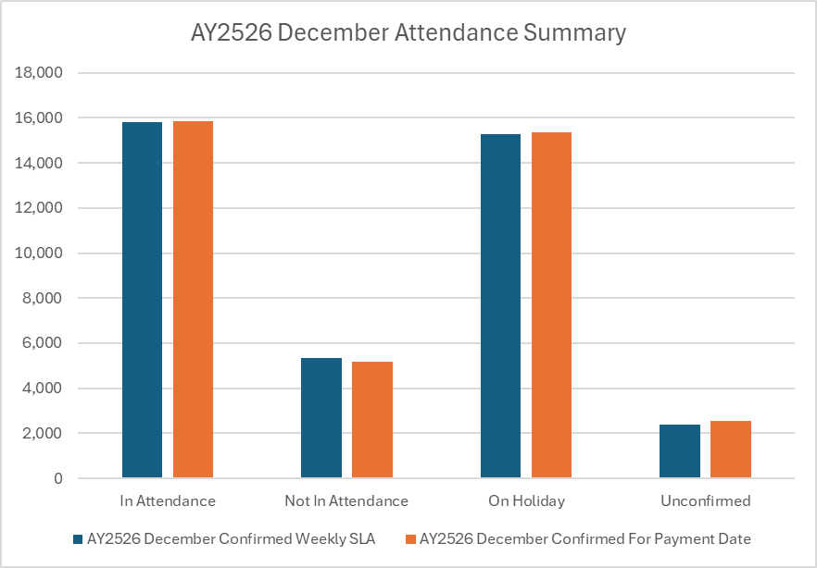
EMA NI – attendance confirmation
December 2025
Attendance position as at | Week end date | Payment date | Number with learning agreement | In attendance | Not In attendance | On holiday | Total confirmed | Total unconfirmed | Percentage confirmed
11/12/2025 | 05/12/2025 | 22/12/2025 | 7,677 | 5,483 | 1,959 | 0 | 7,442 | 235 | 96.9%
18/12/2025 | 05/12/2025 | 22/12/2025 | 7,763 | 5,478 | 1,767 | 0 | 7,245 | 518 | 93.3%
18/12/2025 | 12/12/2025 | 22/12/2025 | 7,763 | 5,513 | 2,063 | 0 | 7,576 | 187 | 97.6%
25/12/2025 | 19/12/2025 | 05/01/2026 | 7,768 | 4,810 | 1,312 | 3 | 6,125 | 1,643 | 78.8%
01/01/2025 | 19/12/2025 | 05/01/2026 | 7,773 | 4,876 | 1,330 | 3 | 6,209 | 1,564 | 79.9%
01/01/2026 | 26/12/2025 | 05/01/2026 | 7,773 | 0 | 0 | 7,523 | 7,523 | 250 | 96.8%
08/01/2026 | 02/01/2026 | 19/01/2026 | 7,823 | 0 | 0 | 7,764 | 7,764 | 59 | 99.2%
15/01/2026 | 02/01/2026 | 19/01/2026 | 7,860 | 1 | 0 | 7,825 | 7,826 | 34 | 99.6%

Slide 52
EMA NI – bonus confirmations
January bonus completion | AY 2023/24 | AY 2024/25 | AY 2025/26
19/01/2026 | 81% | 78% | 82%
26/01/2026 | 90% | 82% | 89%
02/02/2026 | 91% | 90% | 93%
June bonus completion | AY 2023/24 | AY 2024/25
04/06/2025 | 30% | 34%
18/06/2025 | 76% | 66%
01/07/2025 | 99% | 100%

Slide 53

Summary
Please promote EMA funding by using materials and internal tools provided by SLC.
You should encourage learners to apply for EMA as soon as possible.
Make sure that you enter holidays by the start of the academic year.
You should encourage the early signing of Learning Agreements.
100% attendances must be administered on a weekly basis.
Monitor your performance via the LC Portal service standards reports.
Reach out to your Account Manager for support or training needs.

Slide 54

FE Account Management Team
emainfo@slc.co.uk
www.gov.uk/slc
EMAinspections@economy-ni.gov.uk

